Slide 1


CSB4201 - DESIGN AND ANALYSIS AND ALGORITHMS
B.Tech – III Semester – Unit V
Dr. J. Thangakumar
Associate professor
School of Computing Sciences,
Department of Computer Science and Engineering

Slide 2
Lecture 49 Topic : P and NP problems

Slide 3
Lower Bounds
Lower bound: an estimate on a minimum amount of work needed to solve a given problem
Examples:
number of comparisons needed to find the largest element in a set of n numbers
number of comparisons needed to sort an array of size n
number of comparisons necessary for searching in a sorted array
number of multiplications needed to multiply two n-by-n matrices

Slide 4
Lower Bounds (cont.)
Lower bound can be
an exact count
an efficiency class (Ω)
Tight lower bound: there exists an algorithm with the same efficiency as the lower bound
Problem Lower bound Tightness
sorting (comparison-based) Ω(nlog n) yes
searching in a sorted array Ω(log n) yes
element uniqueness Ω(nlog n) yes
n-digit integer multiplication Ω(n) unknown
multiplication of n-by-n matrices Ω(n²) unknown

Slide 5
Classifying Problem Complexity
Is the problem tractable, i.e., is there a polynomial-time (O(p(n)) algorithm that solves it?
Possible answers:
yes (give example polynomial time algorithms)
no
because it’s been proved that no algorithm exists at all (e.g., Turing’s halting problem)
because it’s been be proved that any algorithm for it would require exponential time
unknown. How to classify their (relative) complexity using reduction?

Slide 6
Problem Types: Optimization and Decision
Optimization problem: find a solution that maximizes or minimizes some objective function
Decision problem: answer yes/no to a question
Many problems have decision and optimization versions.
E.g.: traveling salesman problem
optimization: find Hamiltonian cycle of minimum length
decision: find Hamiltonian cycle of length ≤ L
Decision problems are more convenient for formal investigation of their complexity.

Slide 7
Class P
P: the class of decision problems that are solvable in O(p(n)) time, where p(n) is a polynomial of problem’s input size n
Examples:
searching
element uniqueness
graph connectivity
graph acyclicity
primality testing (finally proved in 2002)

Slide 8
Class NP
NP (nondeterministic polynomial): class of decision problems whose proposed solutions can be verified in polynomial time = solvable by a nondeterministic polynomial algorithm
A nondeterministic polynomial algorithm is an abstract two-stage procedure that:
generates a solution of the problem (on some input) by guessing
checks whether this solution is correct in polynomial time
By definition, it solves the problem if it’s capable of generating and verifying a solution on one of its tries
Why this definition?
led to development of the rich theory called “computational complexity”

Slide 9
Example: CNF satisfiability
Problem: Is a boolean expression in its conjunctive normal form (CNF) satisfiable, i.e., are there values of its variables that make it true?
This problem is in NP. Nondeterministic algorithm:
Guess a truth assignment
Substitute the values into the CNF formula to see if it evaluates to true
Example: (A | ¬B | ¬C) & (A | B) & (¬B | ¬D | E) & (¬D | ¬E)
Truth assignments:
A B C D E
0 0 0 0 0
. . .
1 1 1 1 1
Checking phase: O(n)

Slide 10
What other problems are in NP?
Hamiltonian circuit existence
Partition problem: Is it possible to partition a set of n integers into two disjoint subsets with the same sum?
Decision versions of TSP, knapsack problem, graph coloring, and many other combinatorial optimization problems.
All the problems in P can also be solved in this manner (but no guessing is necessary), so we have:
P ⊆ NP
Big (million dollar) question: P = NP ?

Slide 11
NP-Complete Problems
A decision problem D is NP-complete if it is as hard as any
problem in NP, i.e.,
D is in NP
every problem in NP is polynomial-time reducible to D
Cook’s theorem (1971): CNF-sat is NP-complete

Slide 12
NP-Complete Problems (cont.)
Other NP-complete problems obtained through polynomial-
time reductions from a known NP-complete problem
Examples: TSP, knapsack, partition, graph-coloring and hundreds of other problems of combinatorial nature

Slide 13
P = NP ? Dilemma Revisited
P = NP would imply that every problem in NP, including all NP-complete problems, could be solved in polynomial time
If a polynomial-time algorithm for just one NP-complete problem is discovered, then every problem in NP can be solved in polynomial time, i.e. P = NP
Most but not all researchers believe that P ≠ NP , i.e. P is a proper subset of NP. If P ≠ NP, then the NP-complete problems are not in P, although many of them are very useful in practice.

Slide 14
Activity https://visualgo.net/en

Slide 15
Lecture 50 Topic : Travelling salesman problem – Knapsack problem

Slide 16
Tackling Difficult Combinatorial Problems
There are two principal approaches to tackling difficult combinatorial problems (NP-hard problems):
Use a strategy that guarantees solving the problem exactly but doesn’t guarantee to find a solution in polynomial time
Use an approximation algorithm that can find an approximate (sub-optimal) solution in polynomial time

Slide 17
Exact Solution Strategies
exhaustive search (brute force)
useful only for small instances
dynamic programming
applicable to some problems (e.g., the knapsack problem)
backtracking
eliminates some unnecessary cases from consideration
yields solutions in reasonable time for many instances but worst case is still exponential
branch-and-bound
further refines the backtracking idea for optimization problems

Slide 18
Approximation Approach
Apply a fast (i.e., a polynomial-time) approximation algorithm to get a solution that is not necessarily optimal but hopefully close to it
Accuracy measures:
accuracy ratio of an approximate solution s_{a}
r(s_{a}) = f(s_{a}) / f(s*) for minimization problems
r(s_{a}) = f(s*) / f(s_{a}) for maximization problems
where f(s_{a}) and f(s*) are values of the objective function f for the approximate solution s_{a} and actual optimal solution s*
performance ratio R_{A} of the algorithm A
the lowest upper bound of r(s_{a}) on all instances

Slide 19
Example 1: Traveling Salesman Problem
Given n cities with known distances between each pair, find the shortest tour that passes through all the cities exactly once before returning to the starting city
Alternatively: Find shortest Hamiltonian circuit in a weighted connected graph
Example:
2
a
b
5
3
8
4
c
d
7

Slide 20
TSP by Exhaustive Search
Tour Cost
a→b→c→d→a 2+3+7+5 = 17
a→b→d→c→a 2+4+7+8 = 21
a→c→b→d→a 8+3+4+5 = 20
a→c→d→b→a 8+7+4+2 = 21
a→d→b→c→a 5+4+3+8 = 20
a→d→c→b→a 5+7+3+2 = 17
More tours?
Less tours?
Efficiency:

Slide 21
Nearest-Neighbor Algorithm for TSP
Starting at some city, always go to the nearest unvisited city, and, after visiting all the cities, return to the starting one
A B
D C
Note: Nearest-neighbor tour may depend on the starting city
Accuracy: R_{A} = ∞ (unbounded above) – make the length of AD arbitrarily large in the above example
1
s_{a} : A – B – C – D – A of length 10
s* : A – B – D – C – A of length 8
6
2
3
3
1

Slide 22
Multifragment-Heuristic Algorithm
Stage 1: Sort the edges in nondecreasing order of weights. Initialize the set of tour edges to be an empty set
Stage 2: Add next edge on the sorted list to the tour, skipping those whose addition would have created a vertex of degree 3 or a cycle of length less than n. Repeat this step until a tour of length n is obtained
Note: R_{A} = ∞, but this algorithm tends to produce better tours than the nearest-neighbor algorithm

Slide 23
Twice-Around-the-Tree Algorithm
Stage 1: Construct a minimum spanning tree of the graph (e.g., by Prim’s or Kruskal’s algorithm)
Stage 2: Starting at an arbitrary vertex, create a path that goes twice around the tree and returns to the same vertex
Stage 3: Create a tour from the circuit constructed in Stage 2 by making shortcuts to avoid visiting intermediate vertices more than once
Note: R_{A} = ∞ for general instances, but this algorithm tends to produce better tours than the nearest-neighbor algorithm

Slide 24
Example
Walk: a – b – c – b – d – e – d – b – a Tour: a – b – c – d – e – a

Slide 25
Christofides Algorithm
Stage 1: Construct a minimum spanning tree of the graph
Stage 2: Add edges of a minimum-weight matching of all the odd vertices in the minimum spanning tree
Stage 3: Find an Eulerian circuit of the multigraph obtained in Stage 2
Stage 3: Create a tour from the path constructed in Stage 2 by making shortcuts to avoid visiting intermediate vertices more than once
R_{A} = ∞ for general instances, but it tends to produce better tours than the twice-around-the-minimum-tree alg.

Slide 26
Example: Christofides Algorithm

Slide 27
Greedy Algorithm for Knapsack Problem
Step 1: Order the items in decreasing order of relative values: v₁/w₁≥… ≥ v_{n}/w_{n}
Step 2: Select the items in this order skipping those that don’t
fit into the knapsack
Example: The knapsack’s capacity is 16
item weight value v/w
1 2 $40 20
2 5 $30 6
3 10 $50 5
4 5 $10 2
Accuracy
R_{A} is unbounded (e.g., n = 2, C = m, w₁=1, v₁=2, w₂=m, v₂=m)
yields exact solutions for the continuous version

Slide 28
Enhanced Greedy Algorithm for Knapsack Problem
Step 1: Order the items in decreasing order of relative values: v₁/w₁≥… ≥ v_{n}/w_{n}
Step 2A: Select the items in this order skipping those that don’t
fit into the knapsack
Step 2B: Select a single item of the largest value that fits into the knapsack
Step 3: Among the two solutions generated in Step 2, choose the better one as the final solution
Example: The knapsack’s capacity is 16
item weight value v/w
1 2 $40 20
2 5 $30 6
3 10 $50 5
4 5 $10 2
Accuracy
R_{A} is 2 (e.g., n = 2, C = m, w₁=1, v₁=2, w₂=m, v₂=m)

Slide 29
Approximation Scheme for Knapsack Problem
Step 1: Order the items in decreasing order of relative values: v₁/w₁≥… ≥ v_{n}/w_{n}
Step 2: For a given integer parameter k, 0 ≤ k ≤ n, generate all subsets of k items or less and for each of those that fit the knapsack, add the remaining items in decreasing order of their value to weight ratios
Step 3: Find the most valuable subset among the subsets generated in Step 2 and return it as the algorithm’s output
Accuracy: f(s*) / f(s_{a}) ≤ 1 + 1/k for any instance of size n
Time efficiency: O(kn^{k+1})
There are fully polynomial schemes: algorithms with polynomial running time as functions of both n and k

Slide 30
Activity https://visualgo.net/en

Slide 31
Lecture 50 Topic : Travelling salesman problem – Knapsack problem – Hamiltonian Circuit

Slide 32
Exact Solution Strategies
exhaustive search (brute force)
useful only for small instances
dynamic programming
applicable to some problems (e.g., the knapsack problem)
backtracking
eliminates some unnecessary cases from consideration
yields solutions in reasonable time for many instances but worst case is still exponential
branch-and-bound
further refines the backtracking idea for optimization problems

Slide 33
Activity https://visualgo.net/en

Slide 34
Lecture 51 Topic : Backtracking

Slide 35
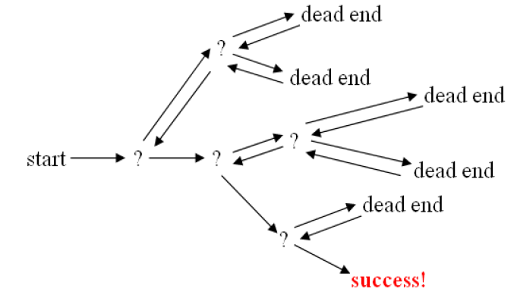
BackTracking
Backtracking is a methodical way of trying out various sequences of decisions, until you find one that “works”

Slide 36
Activity https://visualgo.net/en

Slide 37
Lecture 52 Topic : N- QUEENS PROBLEM

Slide 38
N-Queens Problem:
The object is to place queens on a chess board in such as way as no queen can capture another one in a single move – Recall that a queen can move horz, vert, or diagonally an infinite distance • This implies that no two queens can be on the same row, col, or diagonal – We usually want to know how many different placements there are

Slide 39
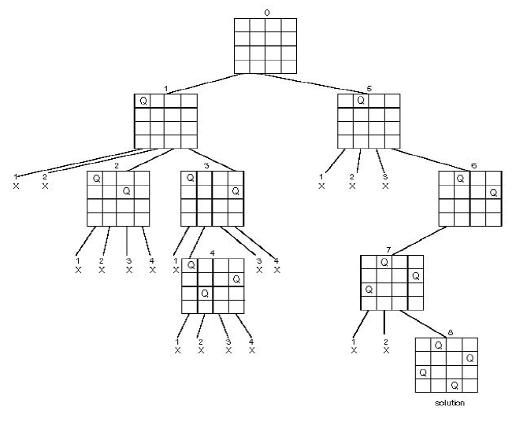
N-Queens Problem:

Slide 40
Activity https://visualgo.net/en

Slide 41
Lecture 53 Topic : The Branch-and-bound strategy

Slide 42
The Branch-and-bound strategy
• 2 mechanisms: – A mechanism to generate branches when searching the solution space – A mechanism to generate a bound so that many braches can be terminated
• It is efficient in the average case because many branches can be terminated very early.
Many NP-hard problem can be solved by B&B efficiently in the average case; however, the worst case time complexity is still exponential.

Slide 43
Activity https://visualgo.net/en

Slide 44
Lecture 54 REVISION

